Slide 1

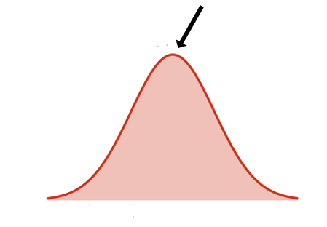
Creative Enough
Raymond Dolan and Alejandra Garza

Slide 2

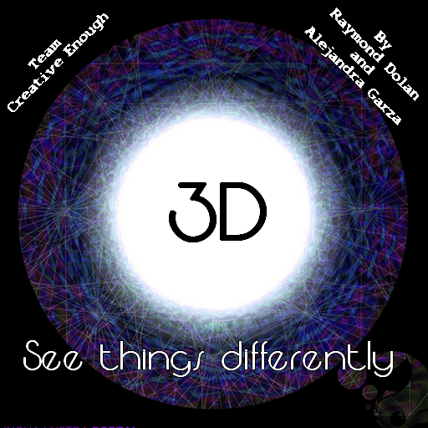
There are three dimensions: goal, walls, and enemy
The player must travel to each dimension in order to figure out how to get to the goal

Slide 3
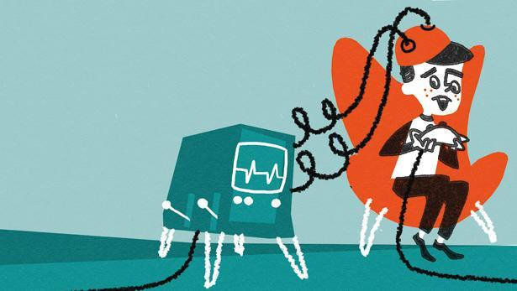
Playtesting

Slide 4
Sound
Completed-level sound
Confusing Introduction of puzzle elements
One-dimensional walls
Replayability

Slide 5
Puzzles increased in difficulty appropriately
Enjoyed last level (a couple wanted more levels)
The controls were easy to understand
People tested both the arrow keys ands WASD

Slide 6
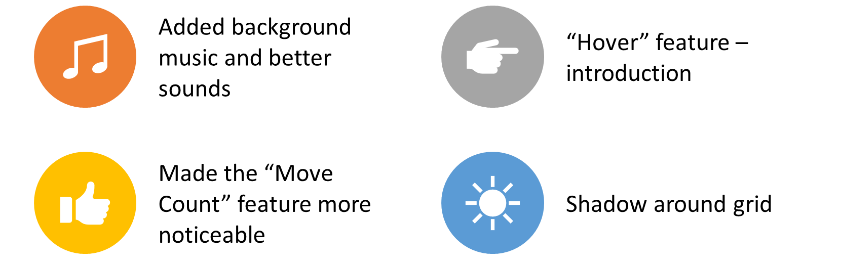
Changes made

Slide 7
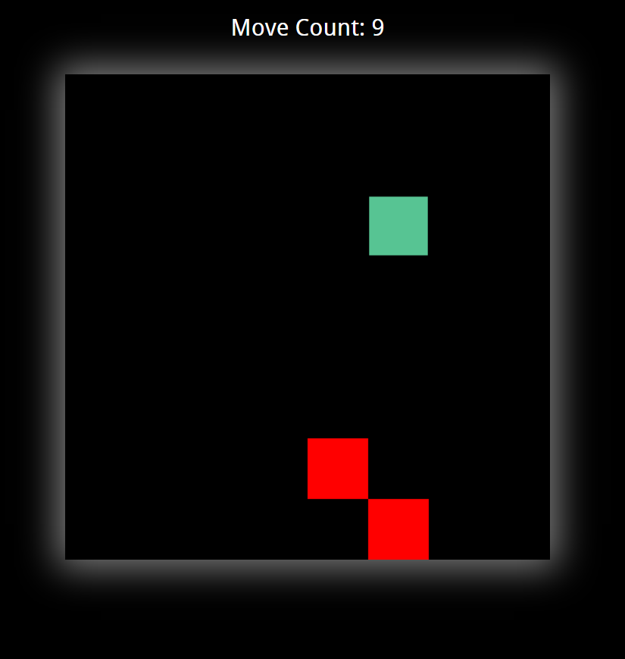
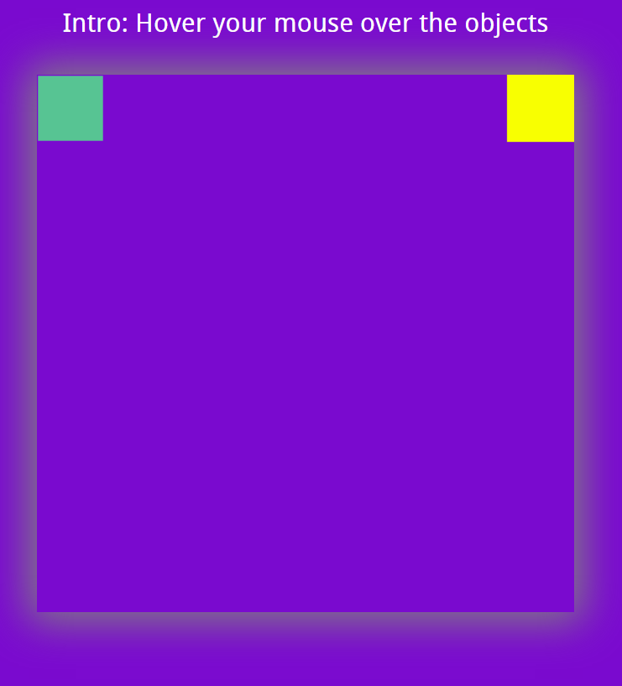

Slide 8

Survey – 14 Responses

Slide 9
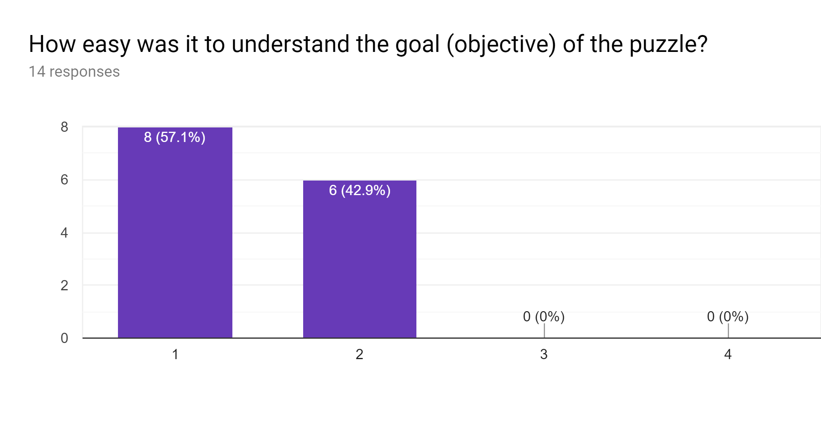
Very Easy
Too Difficult

Slide 10
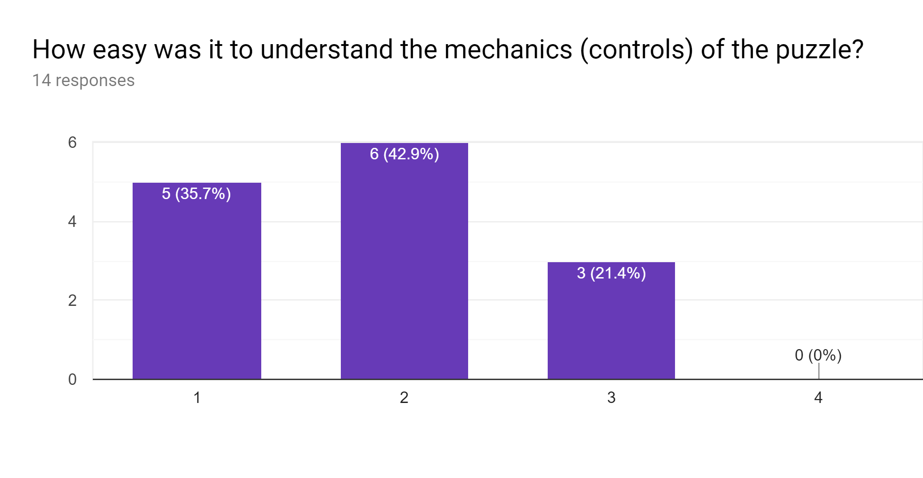
Very Easy
Too Difficult

Slide 11
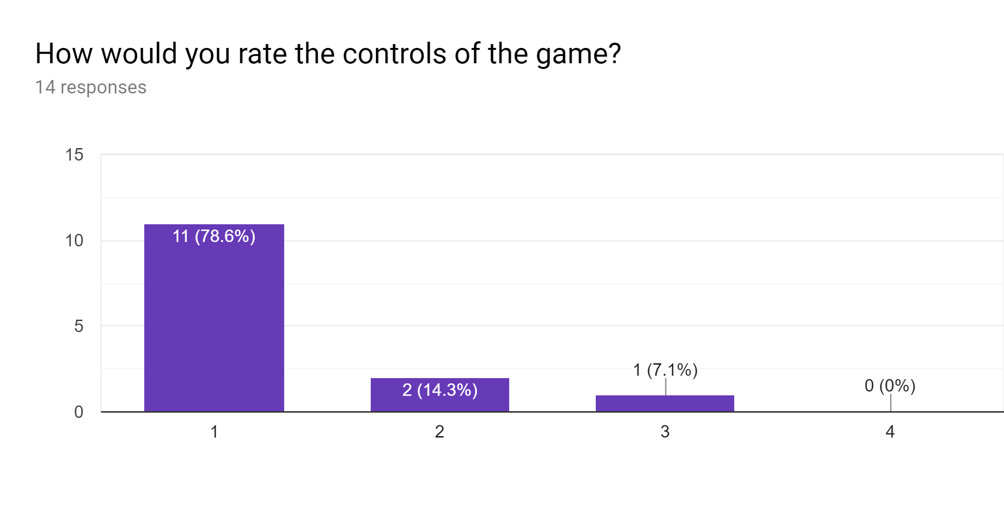
Easy to Understand
Hard to Understand

Slide 12
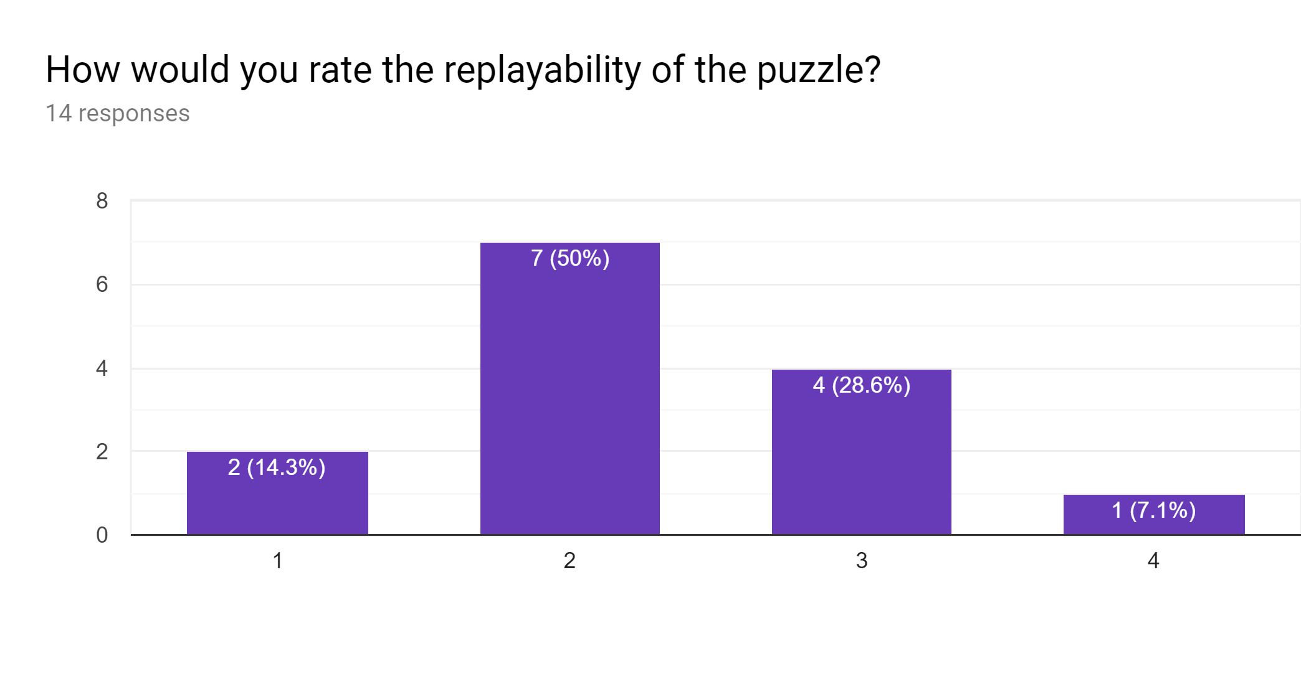
Low
High

Slide 13
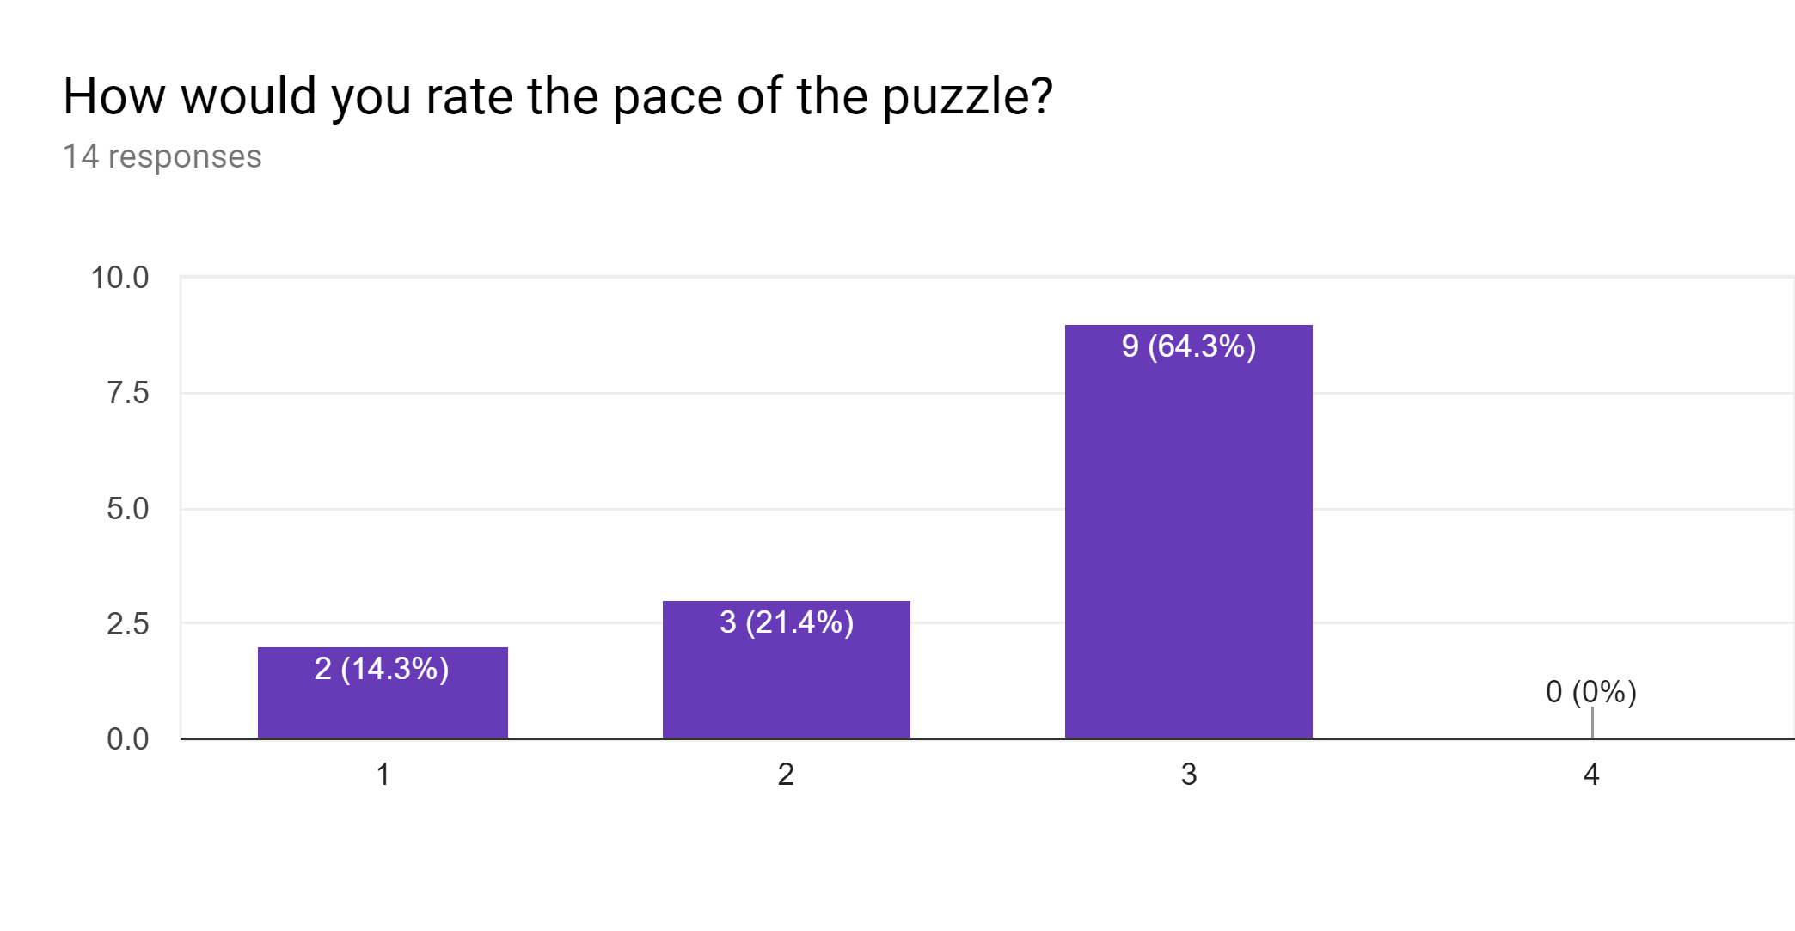
Slow
Rapid

Slide 14
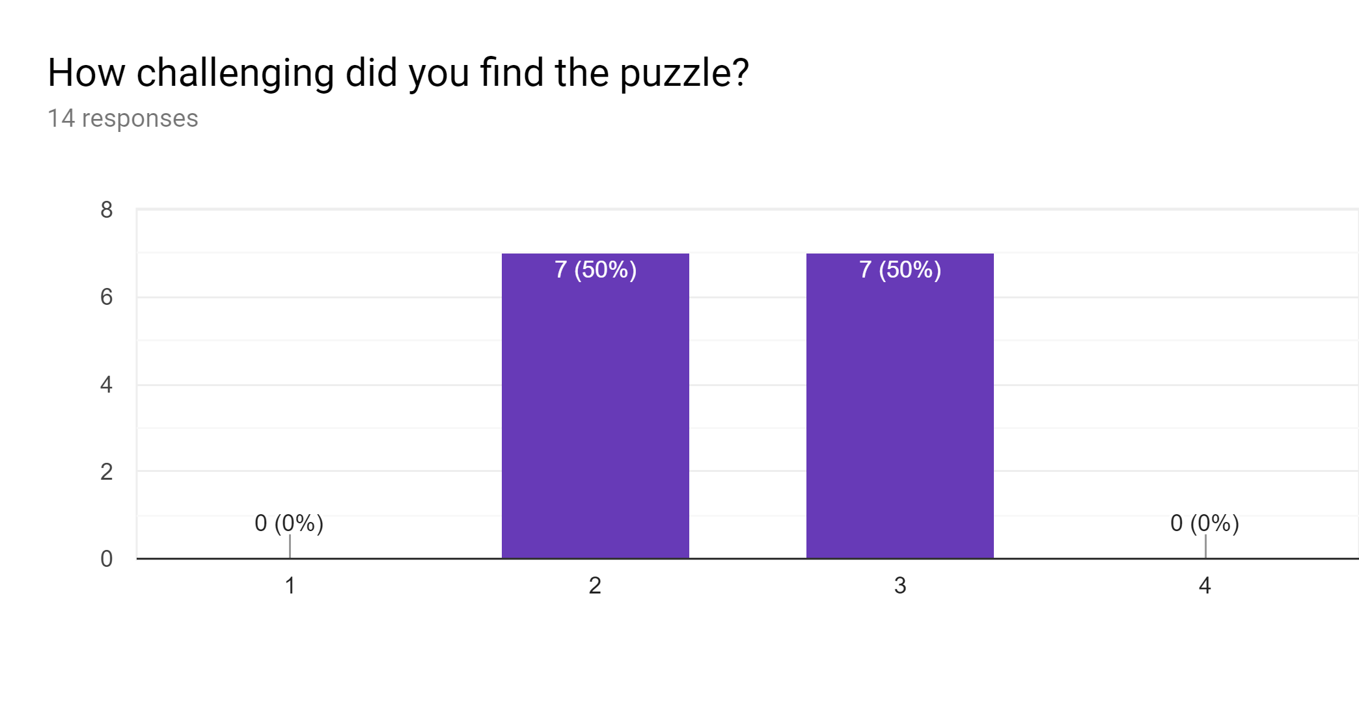
Too Easy
Too Difficult

Slide 15
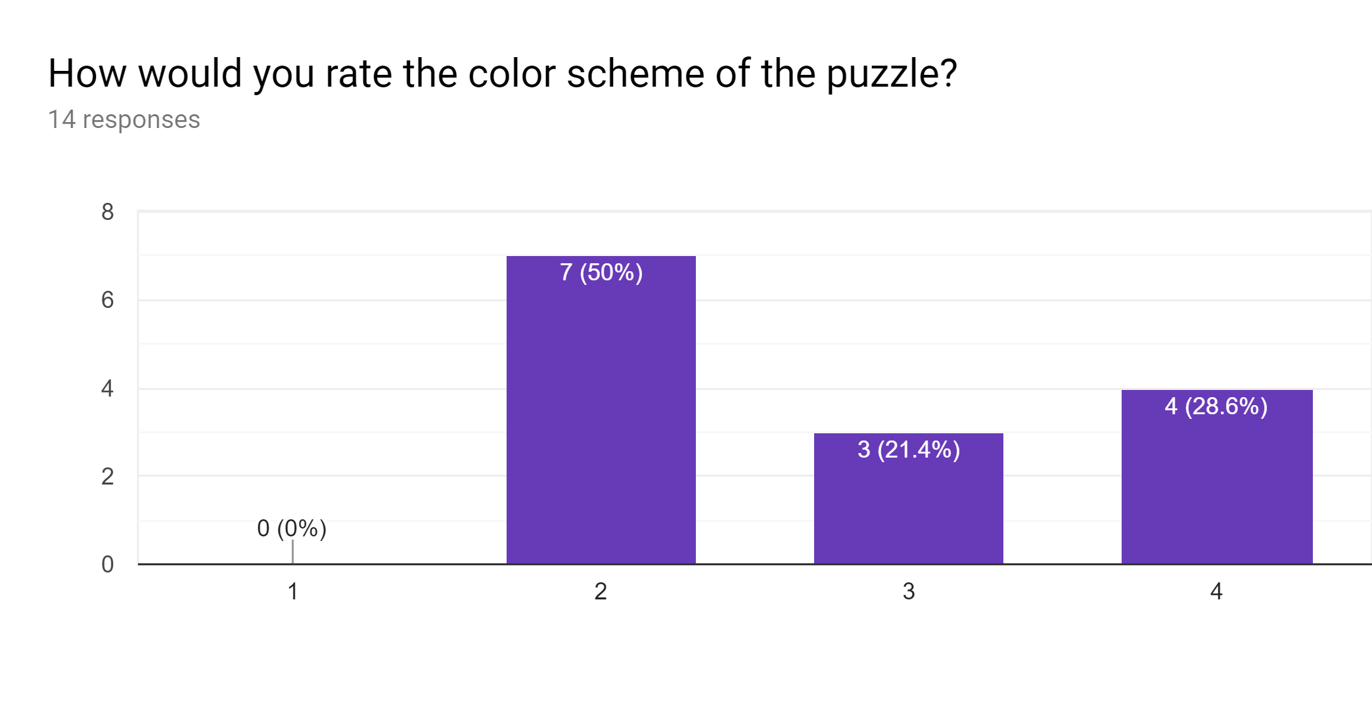
Distracting
Fitting

Slide 16
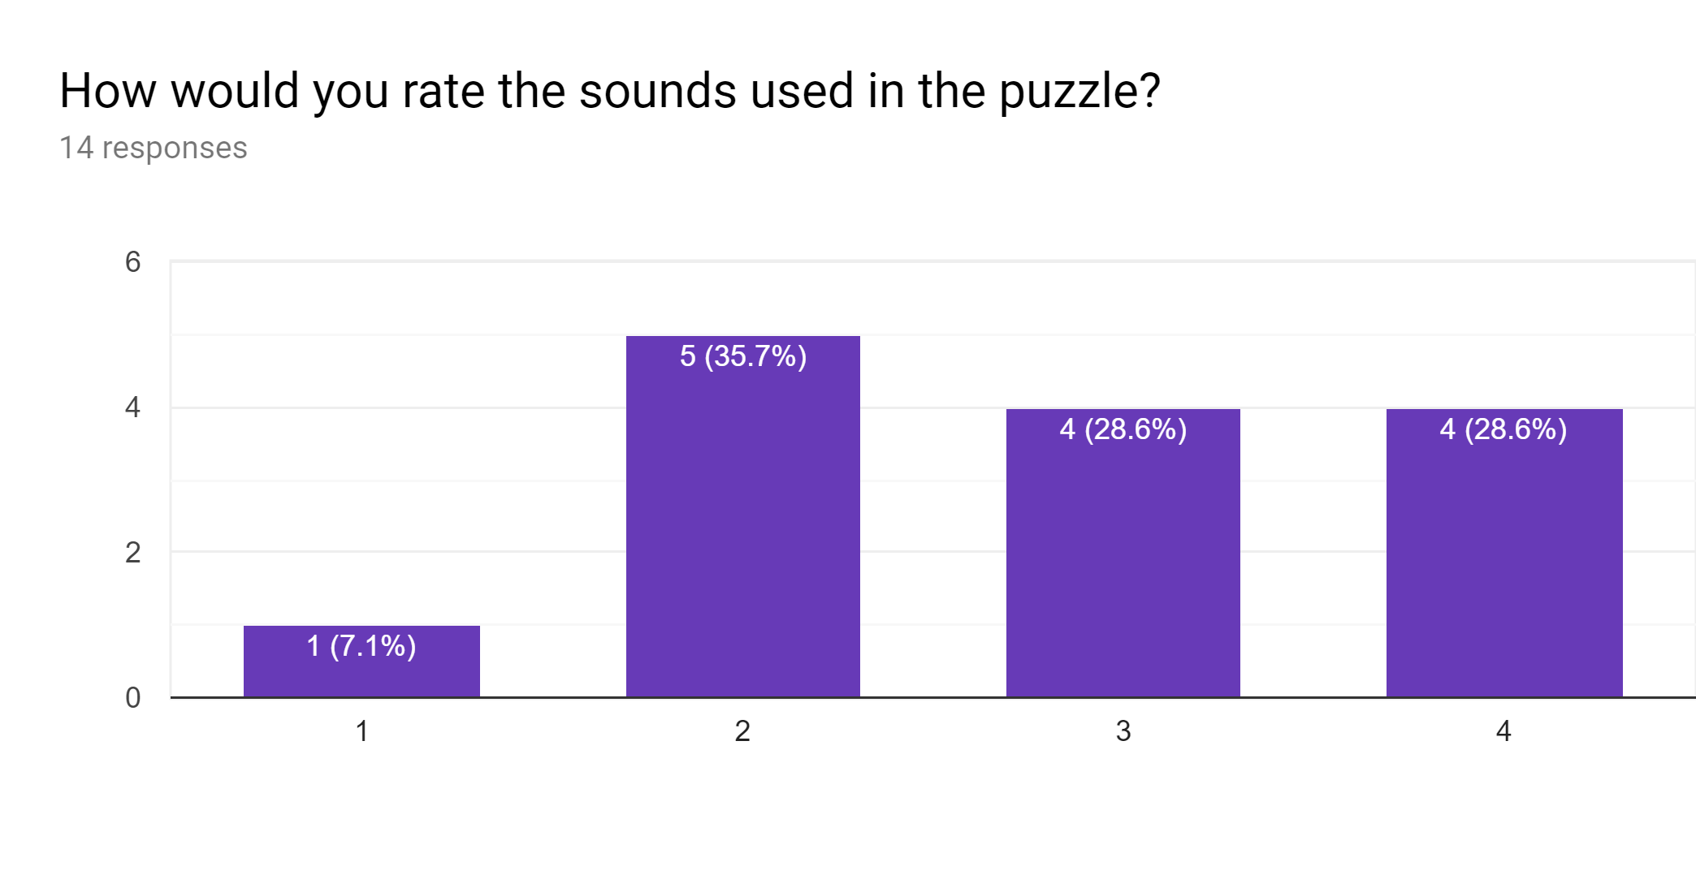
Annoying
Fitting

Slide 17
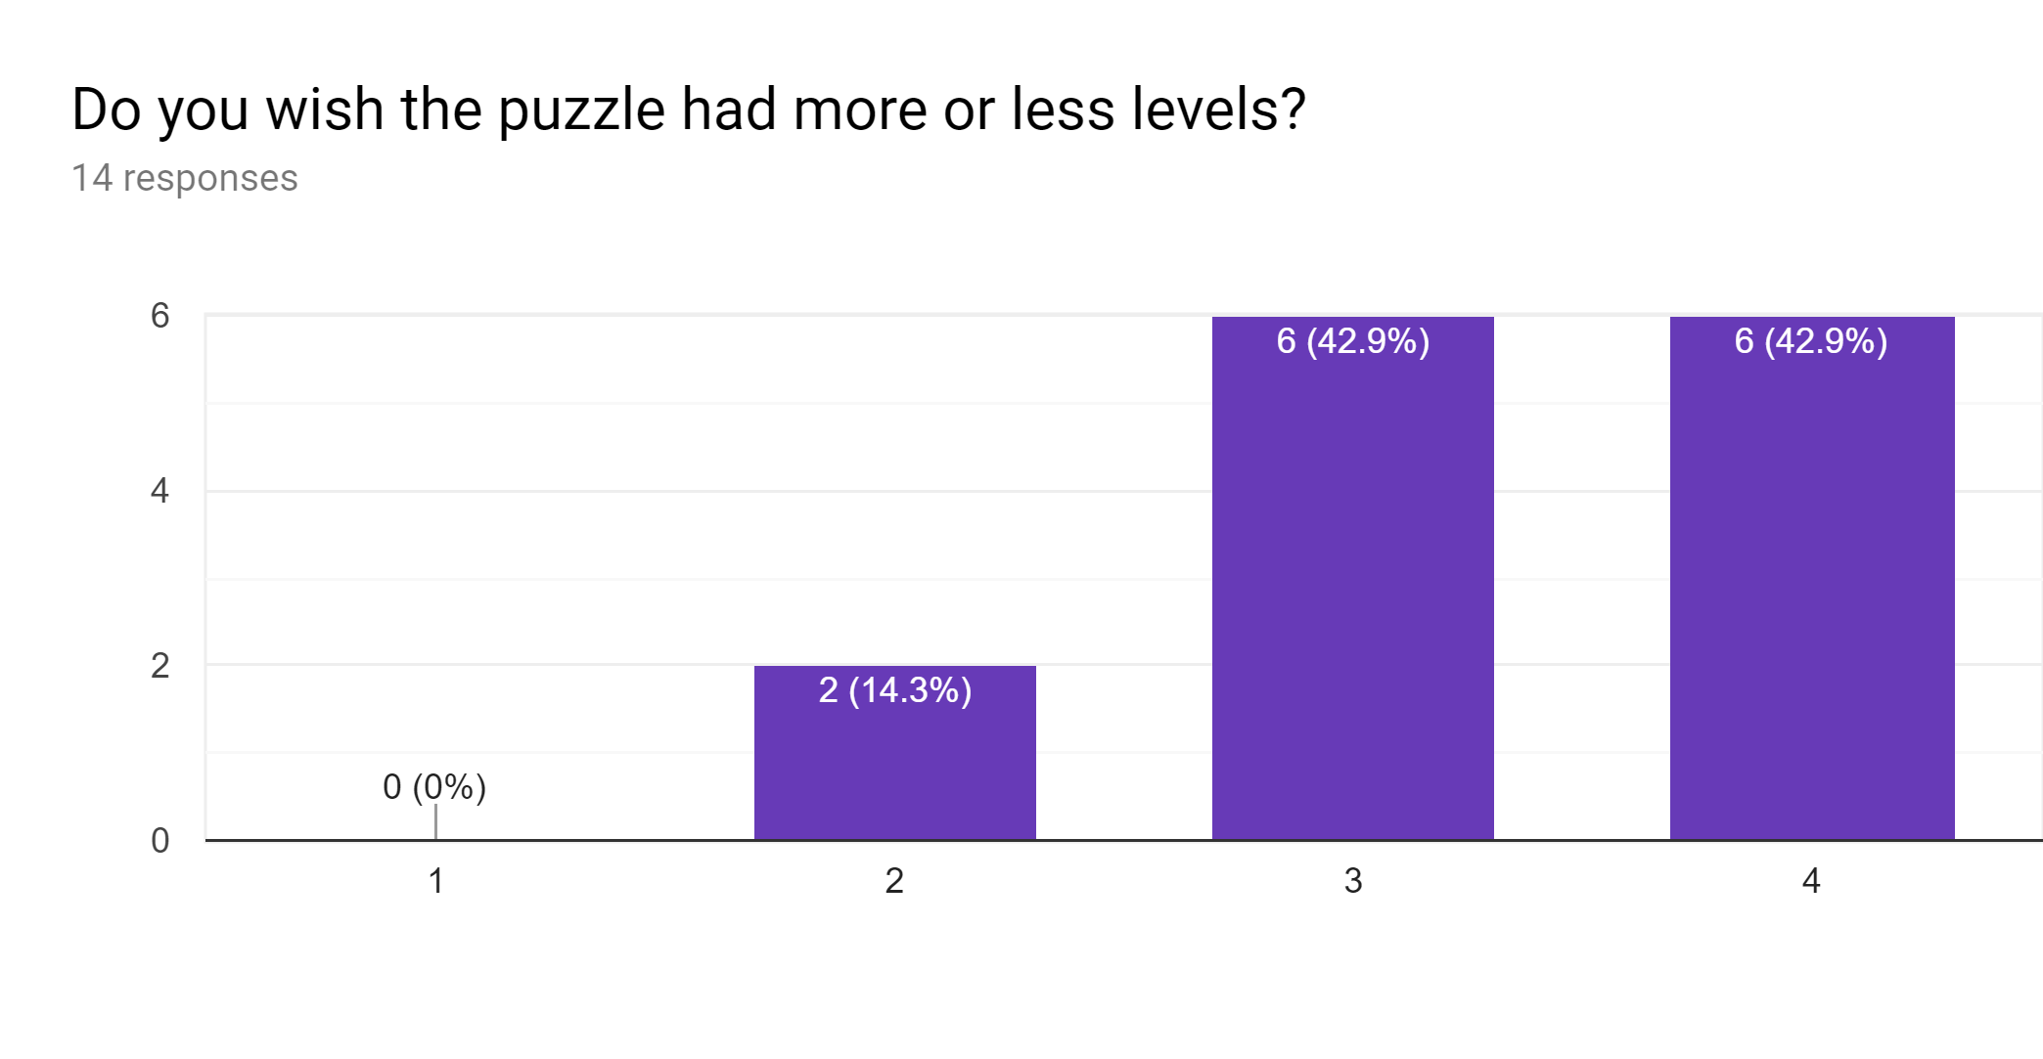
Less
More

Slide 18
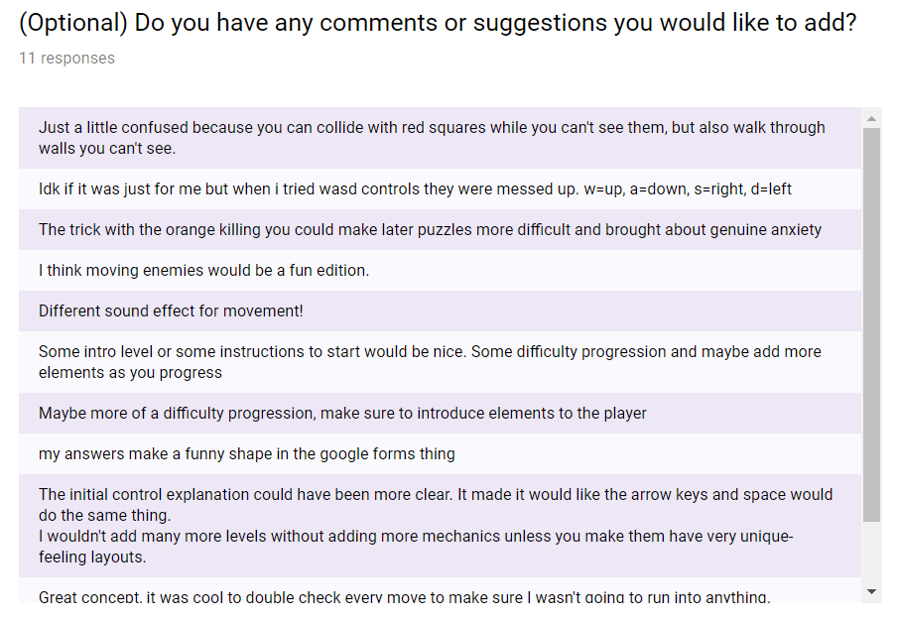

Slide 19

In Class Critique
Positive Feedback
Music and sound effects
Glow around the grid
Hover feature
Suggestions
Add effect for when player changes dimensions

Slide 20
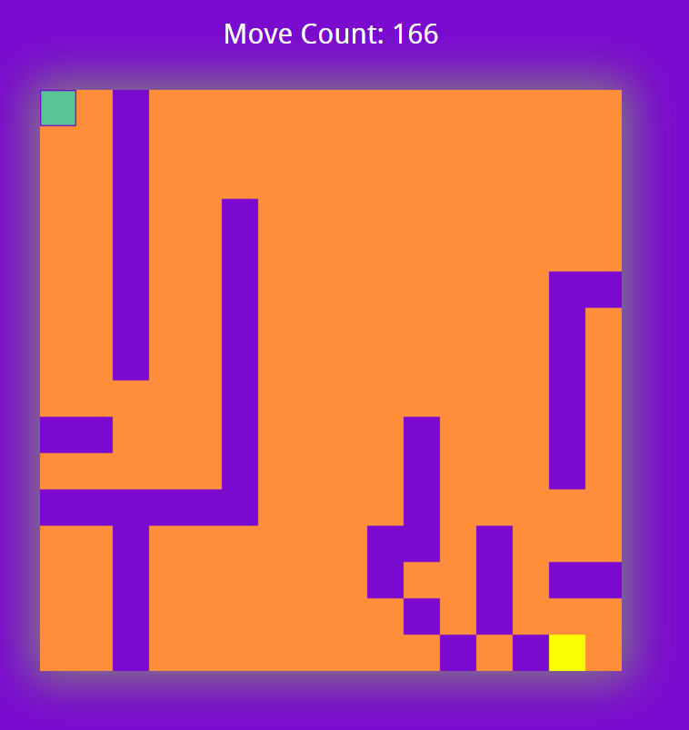
Changes
Did not add suggested effect
Based on feedback
Changed introduction of one-dimensional walls
Added one more level

Slide 21


